Slide 1
Empowering the nation

Slide 2
agenda
Introduction of the team
Introduction of Empowering the Nation
Logo
Website UI's and functionality
Application UI's and functionality

Slide 3
Introducing the team
=Lethauthando Tshabalala (Project Manager and Program Officer)
=Mpilwenhle Van Der Merwe(UI designer and PowerPoint maker)
=Lonwabo Tsekiso(Group leader ad Website Developer)

Slide 4
Brief introduction of empowering the nation
=Empowering the Nation is an initiative founded in 2018 by Precious Radebe to provide skills training for domestic workers and gardeners in her community. The enterprise focuses on offering practical courses to make these individuals more marketable and help them potentially start their own businesses. The initiative also includes a web and mobile platform that advertises services, allows for service requests, and provides quotes. The organization emphasizes both six-month and short six-week courses, enhancing employment opportunities for participants while contributing to community upliftment.
=The initiative’s digital platform, including a website and mobile app, plays a crucial role in promoting the available services, offering users a seamless experience to inquire about courses, receive quotes, and access information. Additionally, the platform supports easy navigation between course offerings, fee calculation, and contact details. The initiative also incorporates mechanisms to verify data entered by users, ensuring a smooth and reliable experience. Empowering the Nation not only fosters personal development but also contributes to broader economic empowerment, with a focus on community growth and sustainability.

Slide 5

Logo
The logo of "Empowering the Nation", featuring hands uplifting people, symbolizes the core mission of our organization: to provide support and lift individuals towards a better future. The hands represent care, guidance, and community, emphasizing that our skills training programs are designed to elevate domestic workers and gardeners by giving them the tools and knowledge they need to succeed.

Slide 6

Website Welcome page
What the page consists:
A convenient and straightforward header.
The logo, the meaning behind it and what it represents.
The company slogan, name and how the two correlate.
The story and initiative behind the company and what "Empowering the nation" does for it's customers.

Slide 7
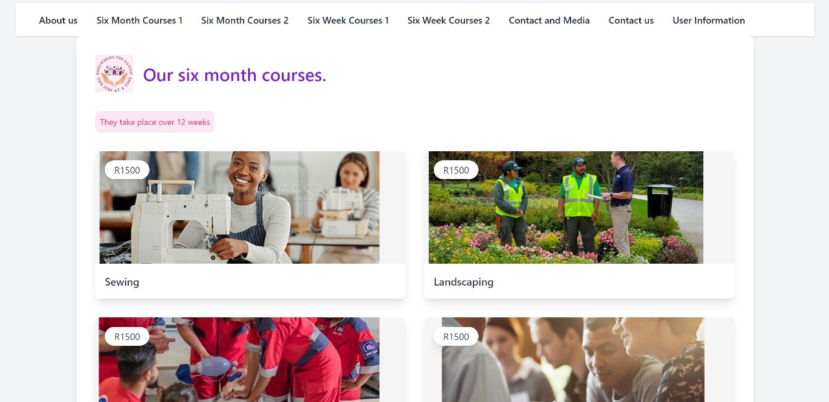
The six month courses Page
Shows all the six months courses the company has to offer
The duration of the course.
The different information on the course,(price, name, etc)
How to access in depth information on the course.

Slide 8
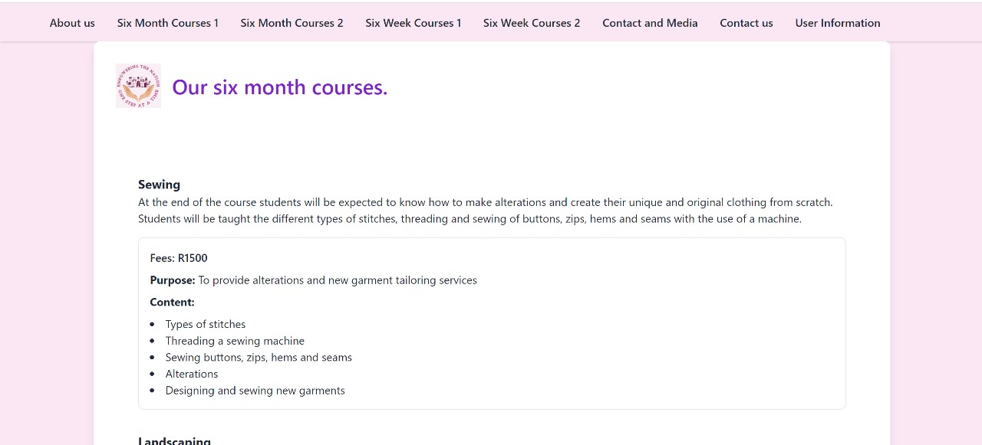
six month course information
Specifics and in depth detail of every six month course.
The fee's, content covered and purpose of the course.

Slide 9
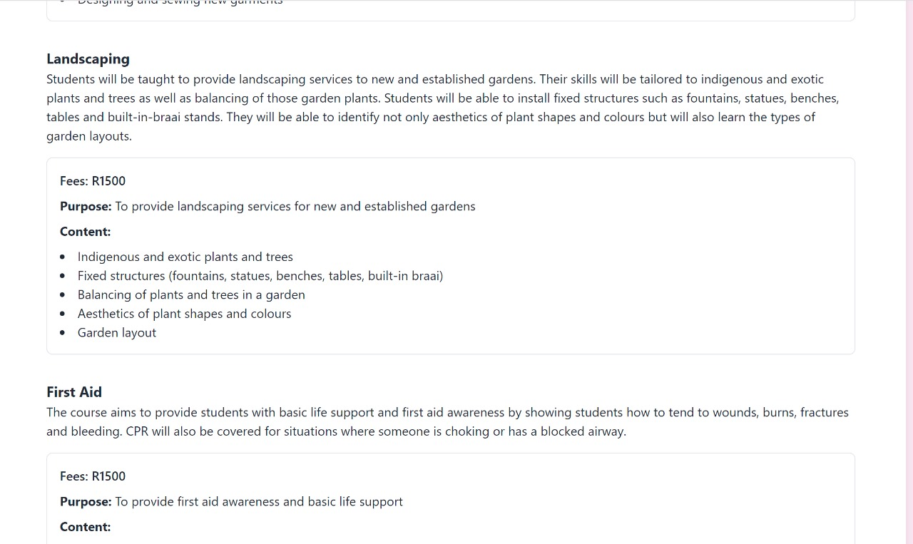
Six month course information

Slide 10
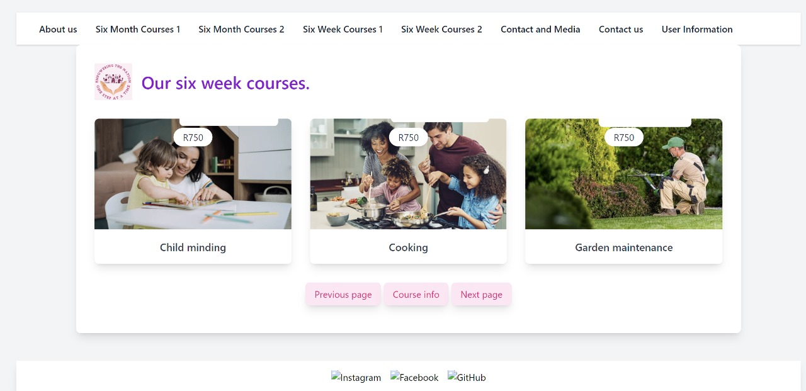
The six week courses
The duration of the course.
The different information on the course,(price, name, etc)
How to access in depth information on the course.
Further functionality including buttons.

Slide 11
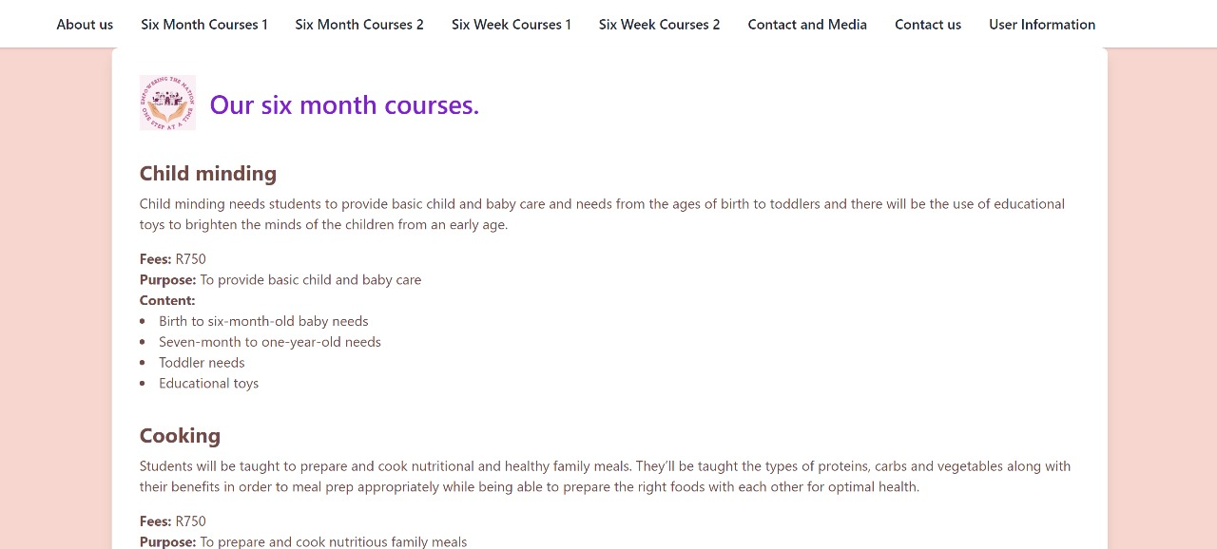
Six week course information
specifics and in depth detail of every six month course.
The fee's, content cover
Further functionality including buttons.

Slide 12
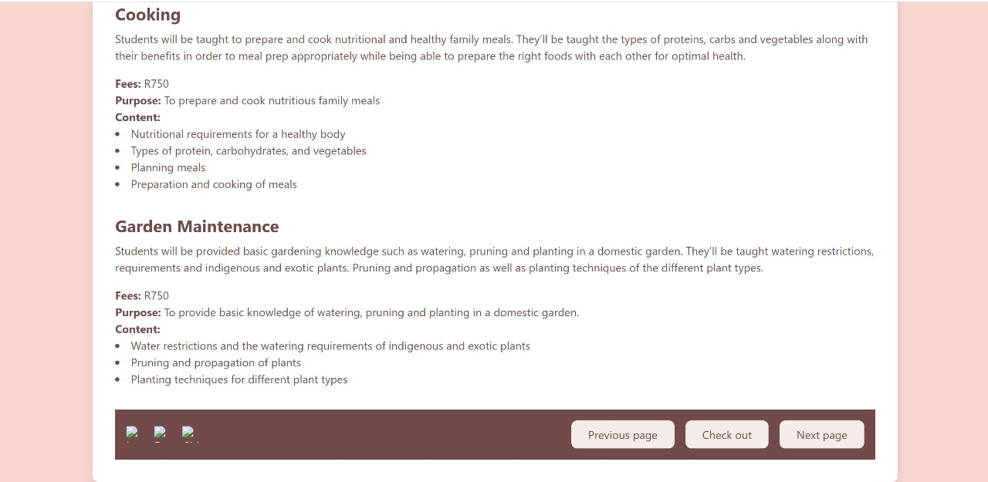
Six week course information
Specifics and in depth detail of every six month course.
The fee's, content cover
Further functionality including buttons.

Slide 13
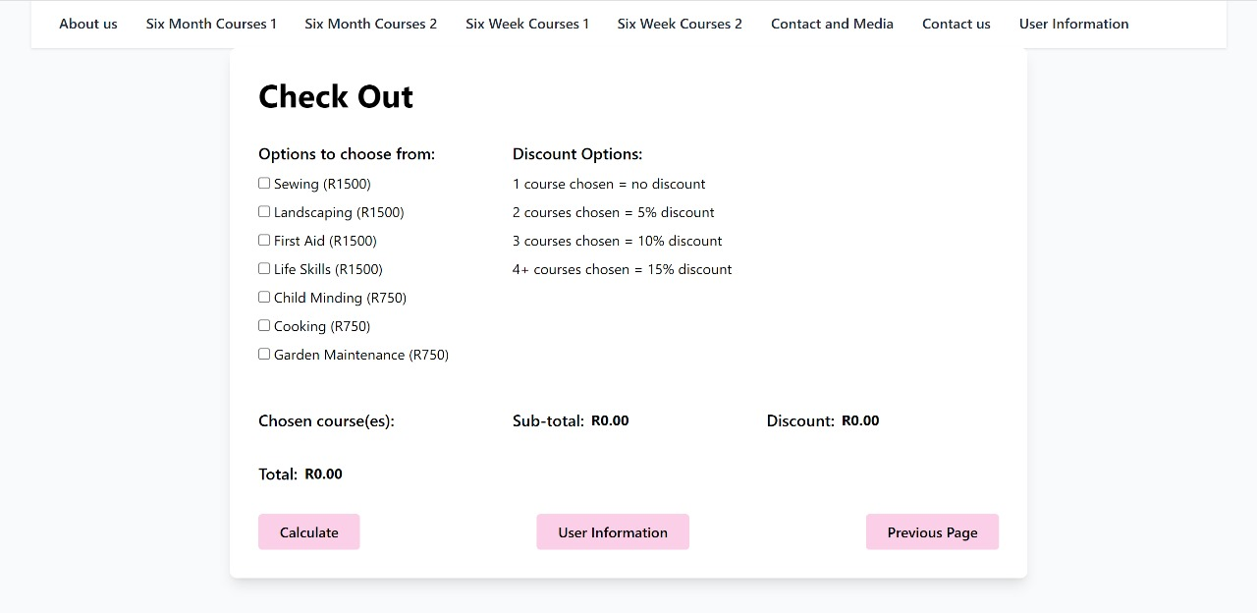
Check out page
The course options to choose from
The discount options and how they work.
The total counting and how it works.
the different user buttons

Slide 14
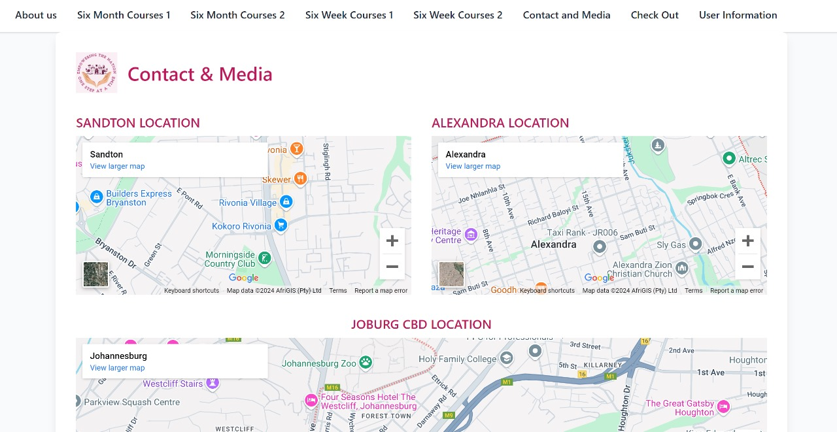
contact and media page
The company locations

Slide 15
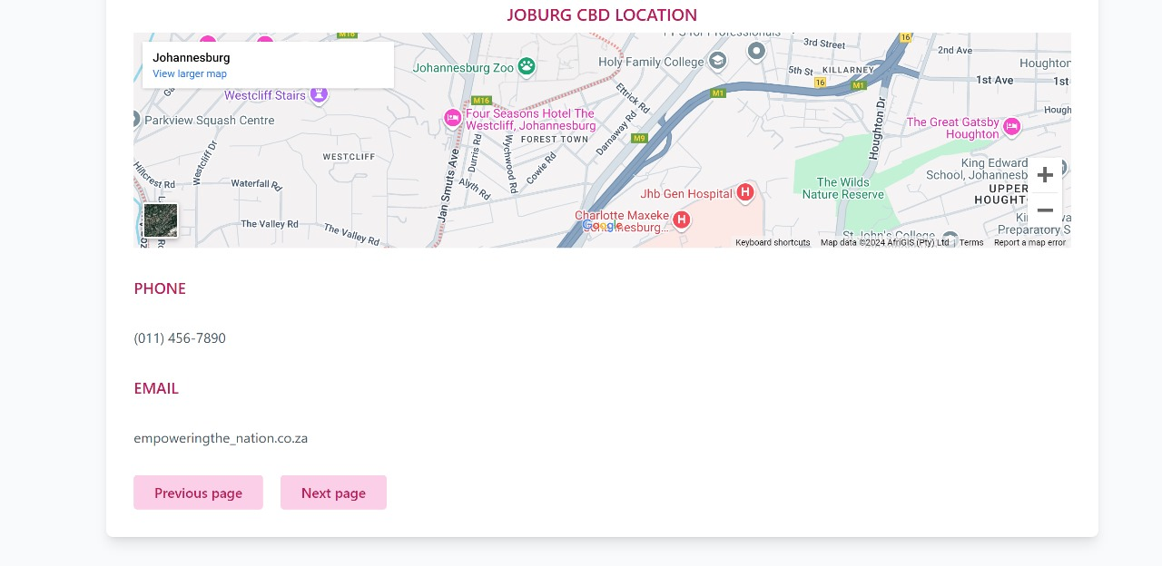
Contact and media
The company phone number
The company email address
User friendly buttons.

Slide 16
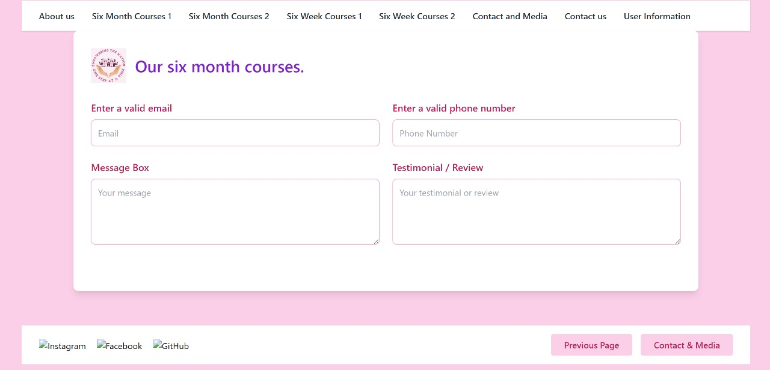
Testimonial page
Box for user prompted email
Box for user promptged phone number
Box for a message by users
Box for users testimonial.

Slide 17
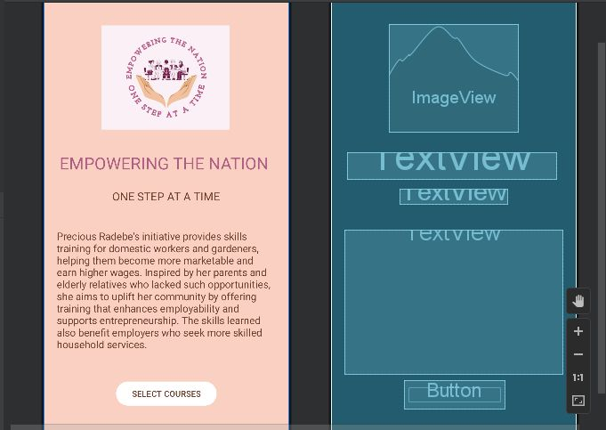
Application welcome page
What the page consists of:
The company logo
The company name and slogan
The story and initiative behind the company and what the company does for it's users.
The user friendly functionality.

Slide 18
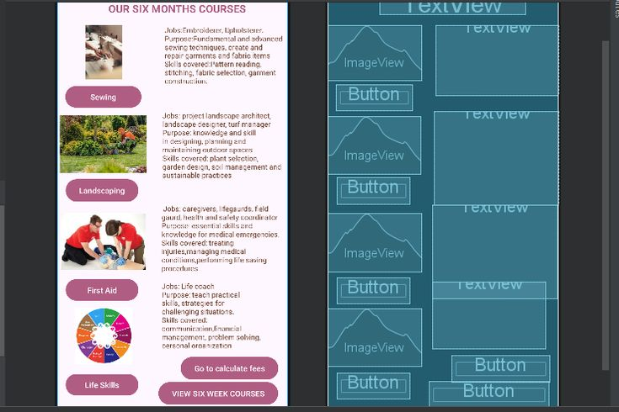
The six month course page
What the page consists of:
The different six month courses provided.
Brief background on what the course consists of to draw users in.
Each course button acts as a hyperlink that navigates to another page containing detailed information on the course.
Hyperlinks that take you to the calculate fees page and the six week course page.

Slide 19
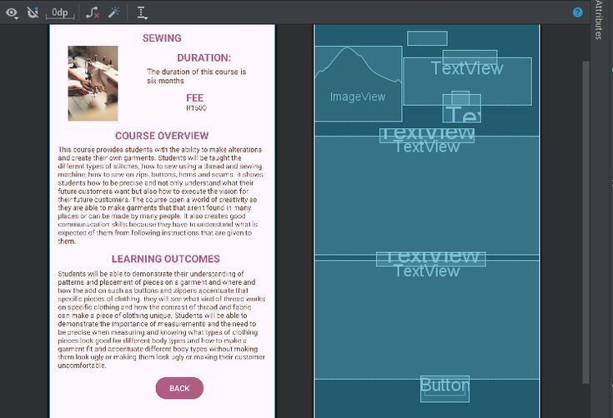
Sewing page
This page consists of:
The duration of the course
The course fee
The in depth explaination of the course.
The learning outcomes of the course.
The button that acts as hyperlink to the six month page.

Slide 20
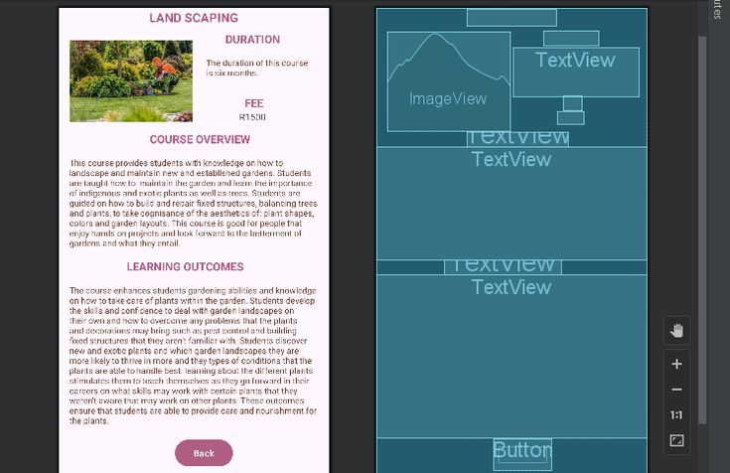
Landscaping page
This page consists of:
The duration of the course
The course fee
The in depth explaination of the course.
The learning outcomes of the course.
The button that acts as a hyperlink to the six month course.

Slide 21
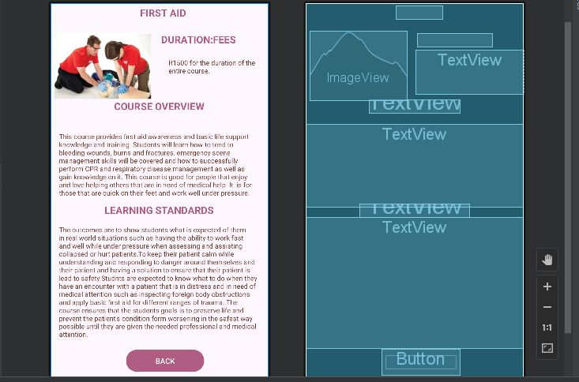
First aid
This page consists of:
The duration of the course
The course fee
The in depth explaination of the course.
The learning outcomes of the course.
The button that acts as a hyperlink to the six month page.

Slide 22
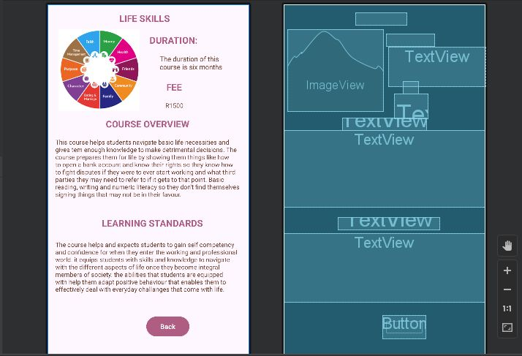
Life skills page
This page consists of:
The duration of the course
The course fee
The in depth explaination of the course.
The learning outcomes of the course.
The button that acts as a hyperlink to the six month page.

Slide 23
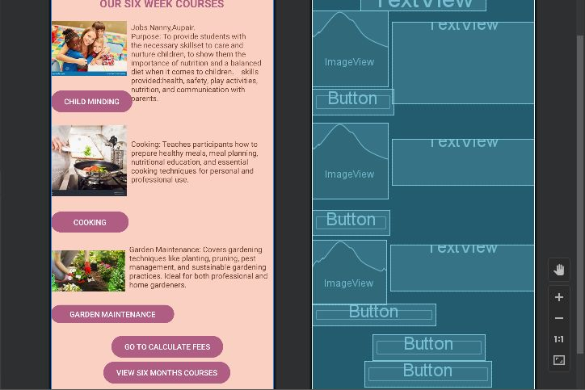
The six week courses
What the page consists of:
The different six month courses provided.
Brief background on what the course consists of to draw users in.
Each course button acts as a hyperlink that navigates to another page containing detailed information on the course.
Hyperlinks that take you to the calculate fees page and month courses.

Slide 24
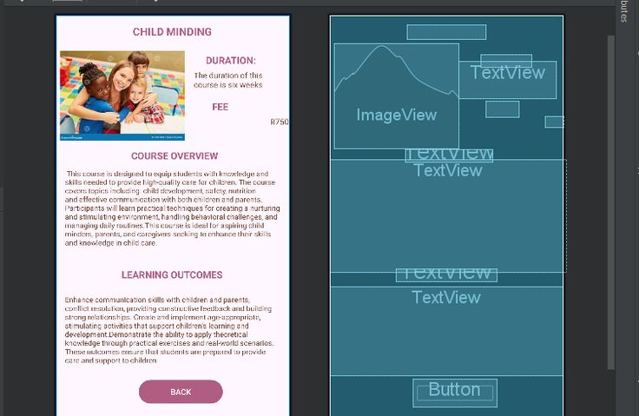
Child minding
This page consists of:
The duration of the course
The course fee
The in depth explaination of the course.
The learning outcomes of the course.
The button that acts as a hyperlink to the six month page.

Slide 25
cooking
This page consists of:
The duration of the course
The course fee
The in depth explaination of the course.
The learning outcomes of the course.
The button that acts as a hyperlink to the six month page.

Slide 26
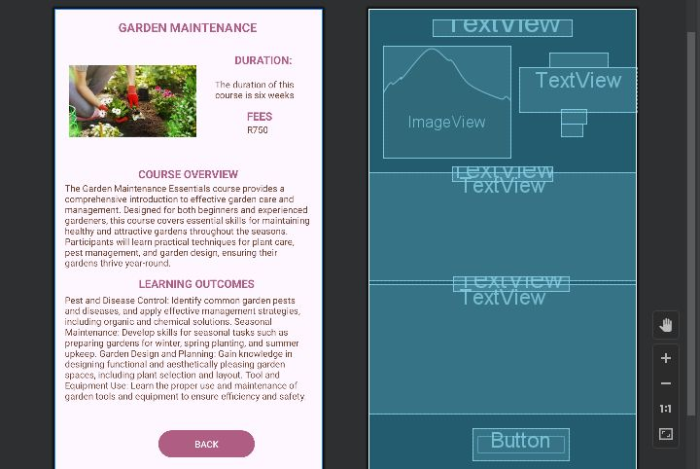
Garden maintainance
This page consists of:
The duration of the course
The course fee
The in depth explaination of the course.
The learning outcomes of the course.
The button that acts as a hyperlink to the six month page.

Slide 27
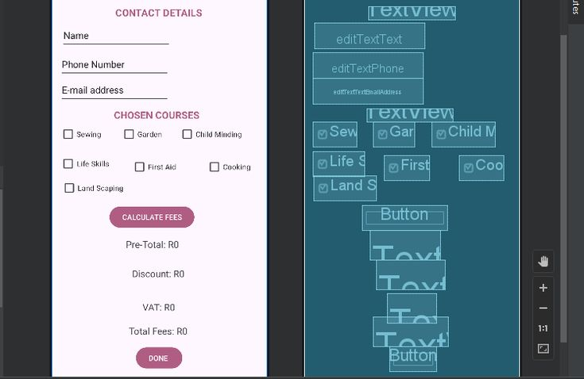
Contact details and calculate fees
Serves as a contact detail that allows the user to input their contact details
Contains checklist boxes for the user to select the courses they wish to enroll in
Has a calculate button that shows the user the pre-total, discount, vat applied as well as the total cost of the selected fees
The done button redirects the user to the final page of the app

Slide 28
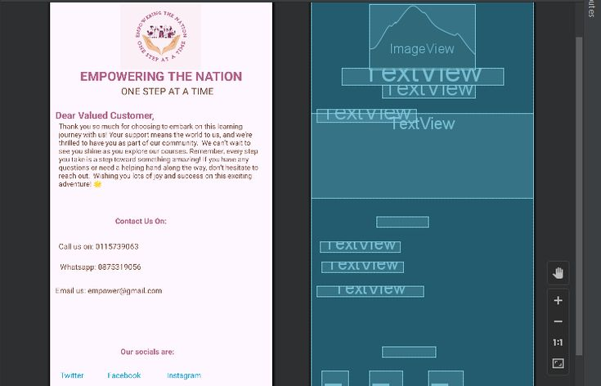
Final page
This page displays the "Thank you " message outputted to the user
Has contact information on where to query if needed
And finally it consists of the social media platforms of the company

